Slide 1
MACHINE LEARNING for BIOINFORMATICS
Predicting Liver DISEASE USING LOGISTIC Regression and GENETIC Algorithm
Presented by
Arkadeep Bagal
Farooq Ansari
Rohan Kumar Singh
Rohit Kumar Majee

Slide 2
OUTLINE
Introduction
What is Machine Learning?
Dataset
Implementation
GUI
Results
Comparative Study
Conclusion

Slide 3
Introduction
In this short presentation, we would like to talk about and explore the various ways popular machine learning algorithms can help us extract useful and actionable data from seemingly ordinary datasets with its implementation.
We would also explore some popular machine learning algorithms and how they work.

Slide 4
WHAT IS MACHINE LEARNING?

Slide 5
DEFINITION
Some popular definitions are as follows
Arthur Samuel(1959): Field of study that gives computers the ability to learn without being explicitly programmed.
Tom Mitchell(1998): A computer program is said to learn from experience(E) with respect to some task (T) and some performance measure (P) , if its performance on T , as measured by P , improves with experience E.

Slide 6
TYPES OF MACHINE LEARNING
Supervised Learning
Linear Regression
Logistic Regression
Unsupervised Learning
Clustering

Slide 7
DATASET
The Dataset that we would be using is called Indian Liver Patient Dataset. It is a popular dataset referenced in literature various times through different research papers on the classification algorithms. There are total 582 records out of which 416 have the disease and 167 do not.

Slide 8
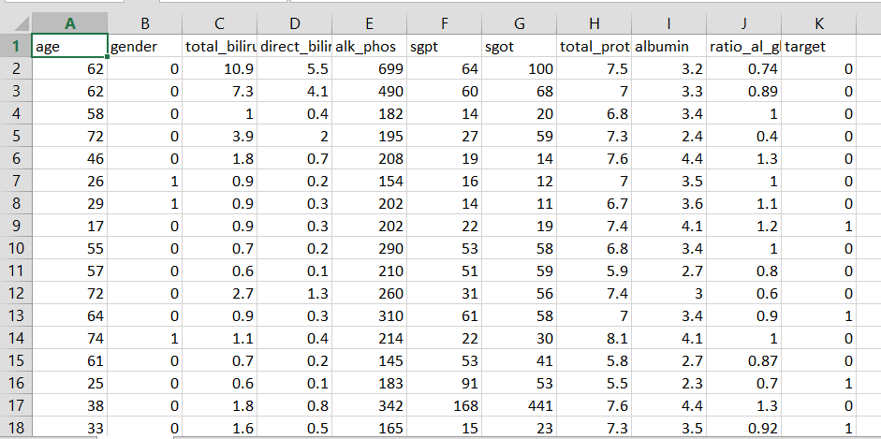
DATASET
The features present in the dataset are as follows:
1. AGE - Age of the patient
2. GENDER - Gender of the patient
3. TB - Total Bilirubin
4. DB - Direct Bilirubin
5. ALKPHOS - Alkaline Phosphotase
6. SGPT - Alamine Aminotransferase
7. SGOT - Aspartate Aminotransferase
8. TP - Total Proteins
9. ALB - Albumin
10. A/G - Ratio Albumin and Globulin Ratio
11. Target – Prediction Variable

Slide 9
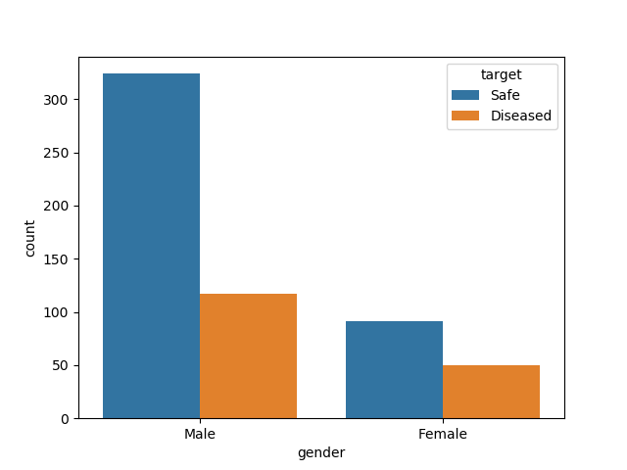
GENDER Distribution

Slide 10
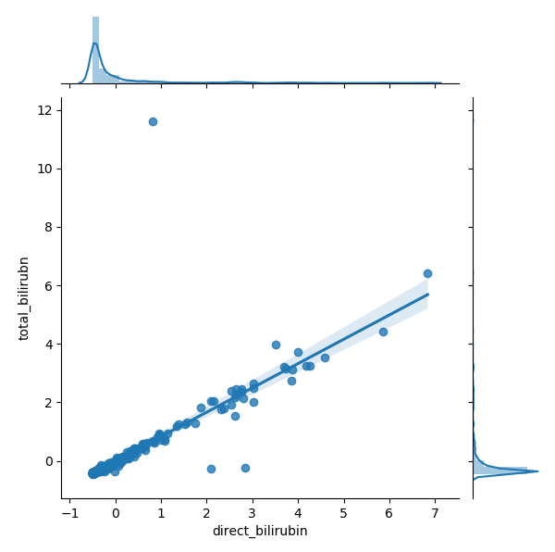
Total Bilirubin v Direct bilirubin

Slide 11
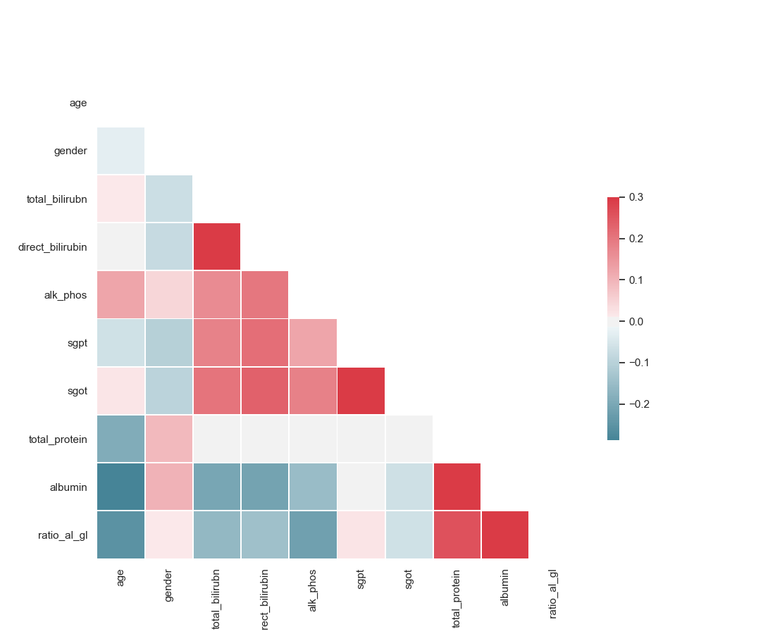
Correlation Matrix
We made a correlation matrix that depicts how some of the features are related to each other, if at all. High correlation among many features imply redundancy in the dataset.

Slide 12
IMPLEMENTATION

Slide 13
PIPELINE
Components of our pipeline:
Data Pre-processing: In this step, the input data is cleaned and processed in a way that enables our machine learning model to run efficiently.
Feature Selection: In this step, we are iterating through all the possible combination of all the possible sizes of the features, and choosing the combination that results in the optimum accuracy.
Model Optimization: In this step, we carried out the process of hyper-parameter tuning that searches for the optimum combination of the logistic regression parameters. We are using Genetic Algorithm to get the best model(which consists of the logistic regression parameters) in reasonable amount of time.

Slide 14
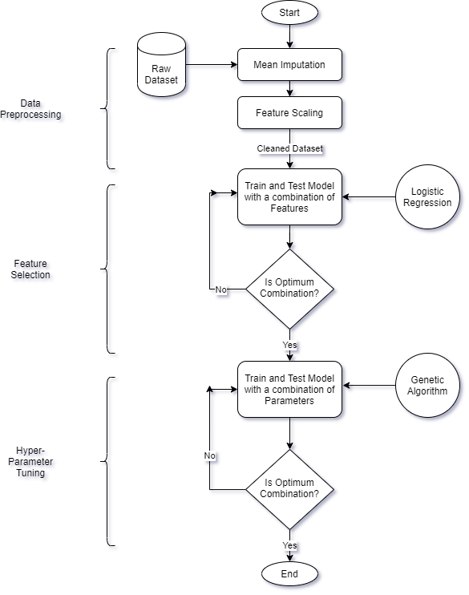
DIFFERENT STAGES OF THE PIPELINE

Slide 15
DATA PRE-PROCESSING
In this stage, we clean our dataset and transform it in a way that helps the model.
It involves:
Encoding String values to Integer
Mean Imputation
Feature Scaling using a Standard Scaler

Slide 16
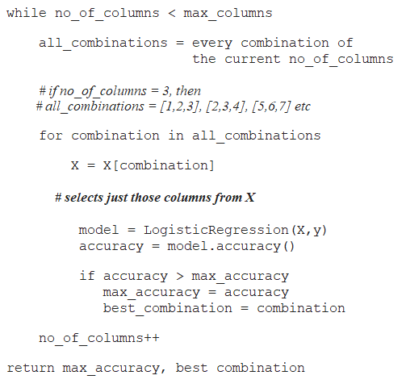
FEATURE SELECTION
we tried to find the optimum combination among the different features of the dataset that results in the maximum accuracy of the model. For that we are iterating through all the possible combination of all the possible sizes of the features, and choosing the combination that results in the optimum accuracy.

Slide 17
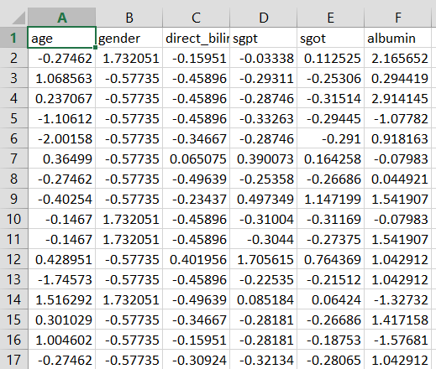
Raw Dataset
Processed and Selected

Slide 18


LOGISTIC Regression
Logistic regression is a supervised machine learning algorithm used for solving classification problems.
For example,
1. To predict whether an email is spam (1) or (0)
2. Whether the tumor is malignant (1) or not (0)
the logistic regression model uses the sigmoid function to squeeze the output of a linear hypothesis (θTx) between 0 and 1.
Here "sig(t)" represents the sigmoid function and "t" is the linear hypothesis,
The output of sigmoid funcition is the estimated probabilty that the "y = 1" ( i.e the prediction is positive)
for a given "x" (input)
(Initial hypothesis which is given to the sigmoid function as input)

Slide 19
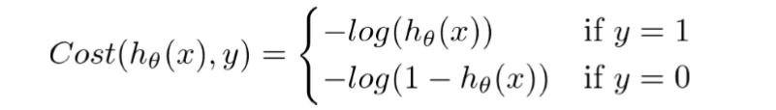
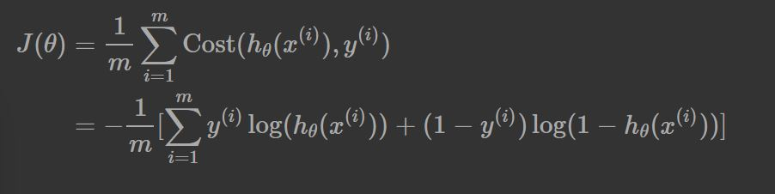
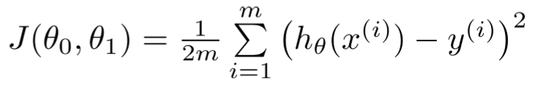
LOGISTIC REGRESSION - COST FUNCTION
The Cost Function represent the optimization objective. Our aim is to minimize this cost function so that we can develop an accurate model with minimum error.
(Traditional cost function that could have been used)
Cost function used in logistic regression

Slide 20
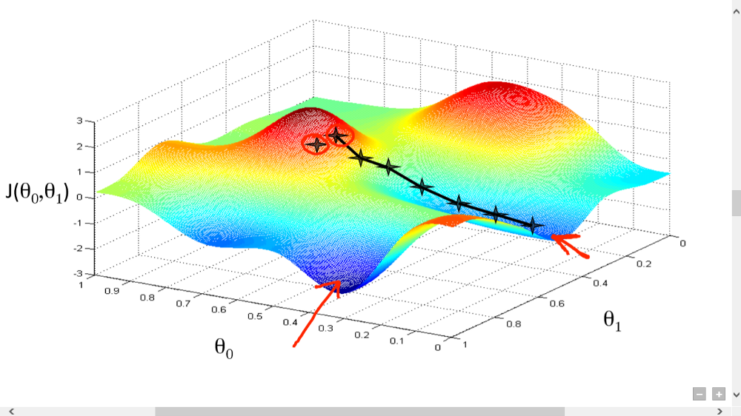
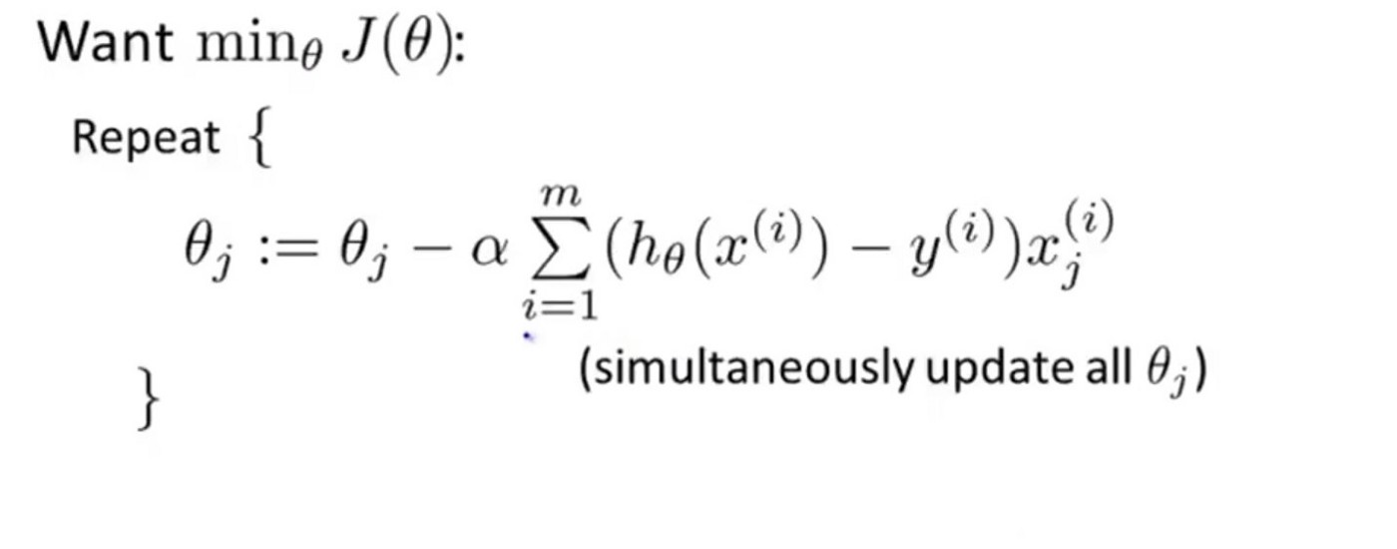
GRADIENT DESCENT

Slide 21
LOGISTIC REGRESSION - MODEL
After selecting features our logistic regression model consist of the following parameters:
C default value=1.0 : Inverse of regularization strength; must be a positive float. Like in support vector machines, smaller values specify stronger regularization.
tolfloat, default=1e-4 :Tolerance for stopping criteria.
penalty{‘l1’, ‘l2’, ‘elasticnet’, ‘none’}, default=’l2’ :Used to specify the norm used in the penalization.
solver{‘newton-cg’, ‘lbfgs’, ‘liblinear’, ‘sag’, ‘saga’}, default=’lbfgs’: Algorithm to use in the optimization problem.

Slide 22
GENETIC ALGORITHM
A Genetic Algorithms is a type of optimization algorithms. It is a stochastic method for function optimization based on the mechanics of natural genetics and biological evolution.
It is a search heuristic that is inspired by Charles Darwin’s theory of natural evolution. This algorithm reflects the process of natural selection where the fittest individuals are selected for reproduction in order to produce offspring of the next generation.

Slide 23
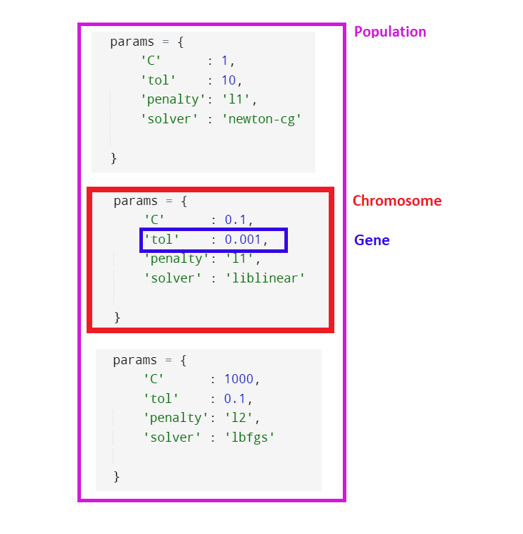
HYPER-PARAMETER TUNING USING GENETIC ALGORITHM
Components of Genetic Algorithm.
1. Random initial population.
2. Fitness Function
3. Selection of random parents
4. Breeding
5. Mutation

Slide 24
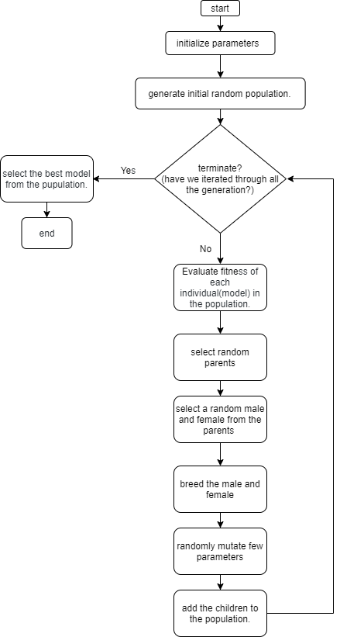

Slide 25
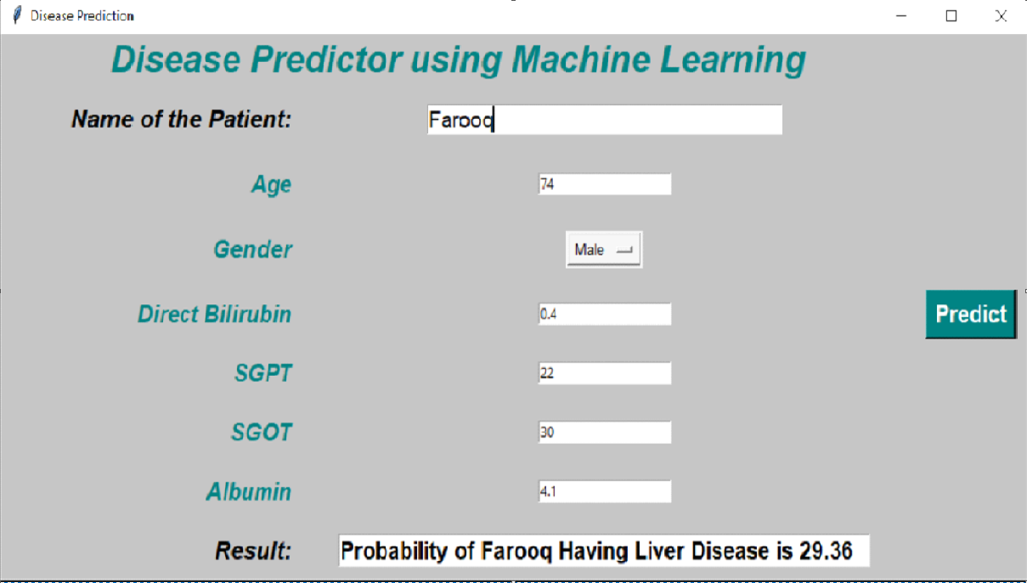
Graphical USER-INTERFACE
In order to make our prediction model interactive and responsive to a query based interface, we used ‘tkinter’ to make a Graphical User Interface to the model

Slide 26
RESULTS

Slide 27
ACCURACY
The model was trained on the aforementioned 436 data points, and then tested on the ‘unknown’ 146 data points.
When we ran our optimized Logistic Regression model, it returned with a 79.45% accuracy. It implies that out of the 146 cases that we tested, the model could correctly predict whether the person with those characteristics would get a heart disease or not 116 times

Slide 28
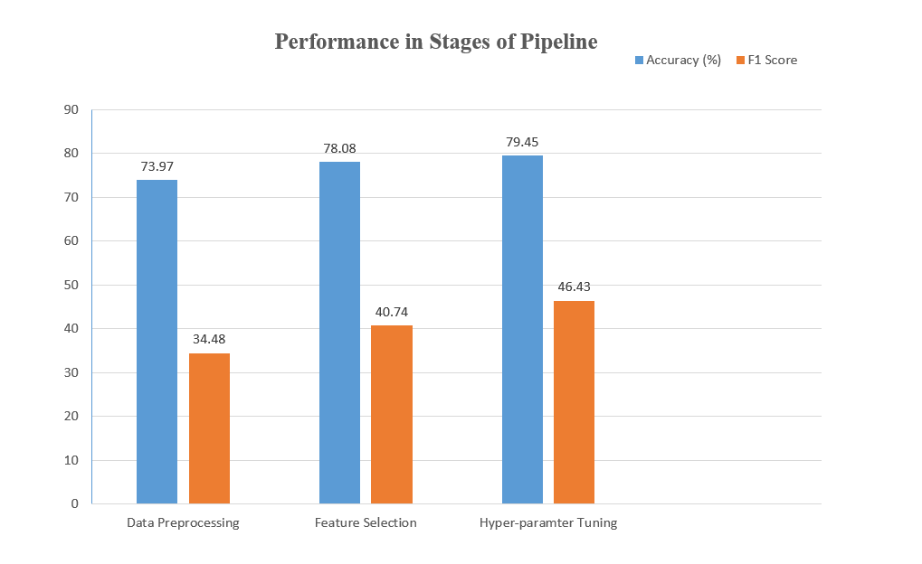
RESULTS

Slide 29
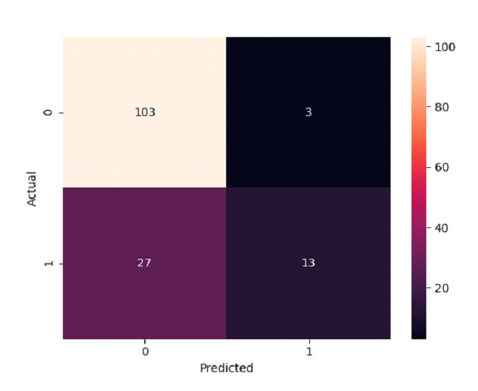
CONFUSION MATRIX
Confusion Matrix is a metric used for prediction models, some relevant terms are as follows:
True Positive: Actually positive, and predicted to be positive.
True Negative: Actually negative, and predicted to be negative
False Positive: Actually negative, and predicted to be positive.
False Negative: Actually positive, and predicted to be negative.

Slide 30
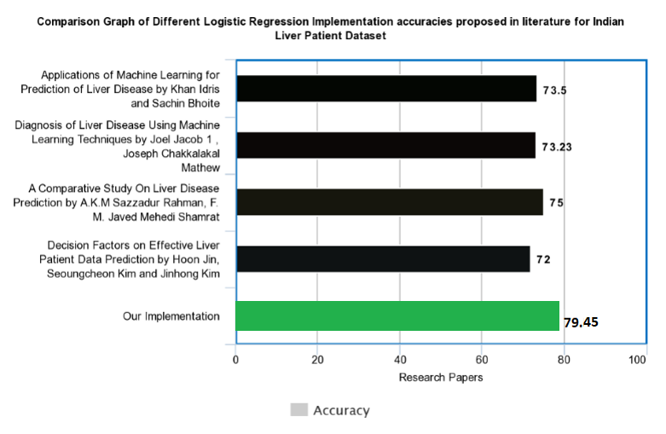
Comparative Study

Slide 31
CONCLUSION
As we can observe, there is plenty of scope in the field of Bio-Medical Informatics for us, as budding Computer Science students to explore and implement ground-breaking algorithms & machine learning pipelines to extract meaningful inferences that can directly help people.
It is our conviction that we would contribute to this ever-growing field and improve our initial understandings.

Slide 32
Acknowledgment
We would like to thank our mentor Mr. Sabyasachi Mukherjee Sir, for his continuous guidance during the preparation for this topic.
We would like to thank the Head of Computer Science & Engineering department, Dr. Monish Chatterjee for providing us with the opportunity to explore such technological fields.

Slide 33
REFERENCES
1. Dataset was taken from the popular UCI Machine Learning Repository
https://archive.ics.uci.edu/ml/datasets/ILPD+(Indian+Liver+Patient+Dataset)
2. The Python in-built machine learning module "Scikit-Learn"
https://scikit-learn.org/stable/
3. Understanding of the Algorithms and various Data Science costructs from the popular MOOC by Andrew Ng
https://www.coursera.org/learn/machine-learning-with-python
4. Genetic Algorithm Implementation
https://bmcbioinformatics.biomedcentral.com/articles/10.1186/1471-2105-15-S16-S11
5. More information on Genetic Algorithm
https://blog.coast.ai/lets-evolve-a-neural-network-with-a-genetic-algorithm-code-included-8809bece164

